Slide 1

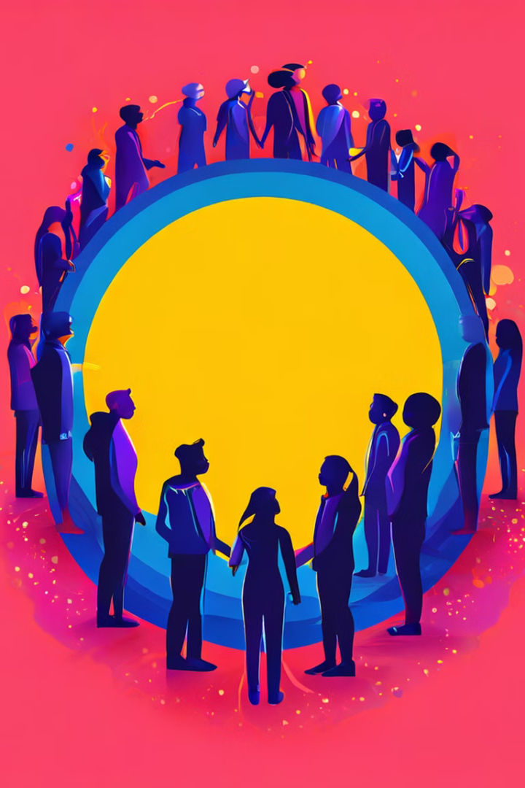
Racism and Discrimination: An In-depth Analysis
This presentation examines the complex and pervasive issues of racism and discrimination, exploring their definitions, impacts, historical context, and potential solutions.
Rachael Mawia

Slide 2

Definition and Impact
1
Racism
2
Discrimination
3
Impact
The belief that different races possess distinct characteristics, abilities, or qualities, which can be used to differentiate them as inferior or superior to one another.
The unjust or prejudicial treatment of different categories of people, often based on race, age, gender, or sexual orientation.
Both racism and discrimination can lead to significant negative consequences, including social exclusion, economic inequality, and psychological harm.

Slide 3
Systemic Racism and Discrimination
Institutional Policies
Historical Practices
Social Structures
Systemic racism refers to the ingrained biases and inequities within institutions, such as the criminal justice system, education system, and healthcare system.
Systemic racism has roots in historical practices like slavery, colonialism, and segregation, which have created lasting inequalities.
Social structures perpetuate these inequalities, often through policies and practices that disproportionately disadvantage certain racial groups.

Slide 4
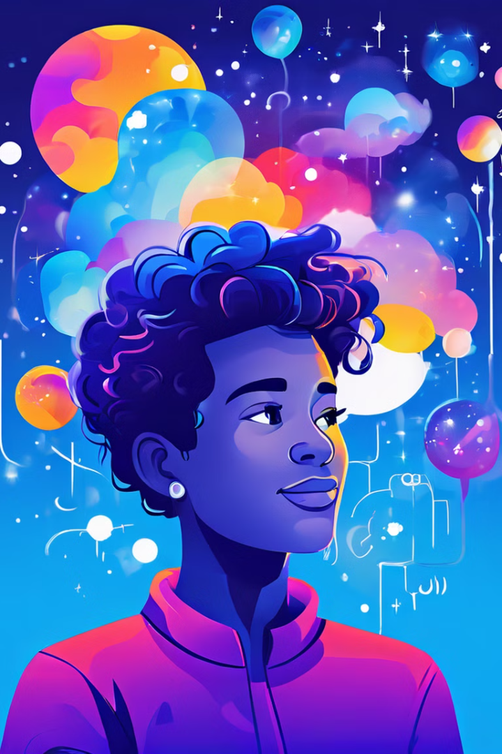
Individual Prejudice and Bias
1
Unconscious Bias
Unconscious bias refers to the automatic judgments and associations that people make without conscious awareness.
2
Stereotypes
Stereotypes are simplified and often inaccurate generalizations about entire groups of people, which can reinforce prejudices.
3
Prejudice
Prejudice is a preconceived opinion or feeling, often negative, about a person or group of people.
4
Discrimination
Discrimination is the action of treating someone differently based on their race, ethnicity, gender, or other protected characteristics.

Slide 5
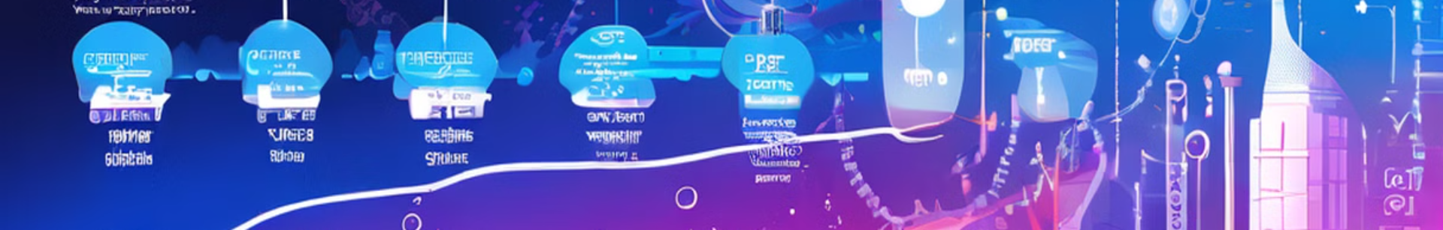




Historical Perspectives
Slavery
Colonialism
Segregation
Civil Rights Movements
The transatlantic slave trade and its lasting impact on racial hierarchies and inequality.
The colonization of various territories led to the exploitation of indigenous populations and the imposition of racialized power structures.
The enforced separation of people based on race, particularly in the United States, led to systematic discrimination and denial of rights.
The fight for racial equality and justice, including the Civil Rights Movement in the United States, challenged segregation and discrimination.

Slide 6
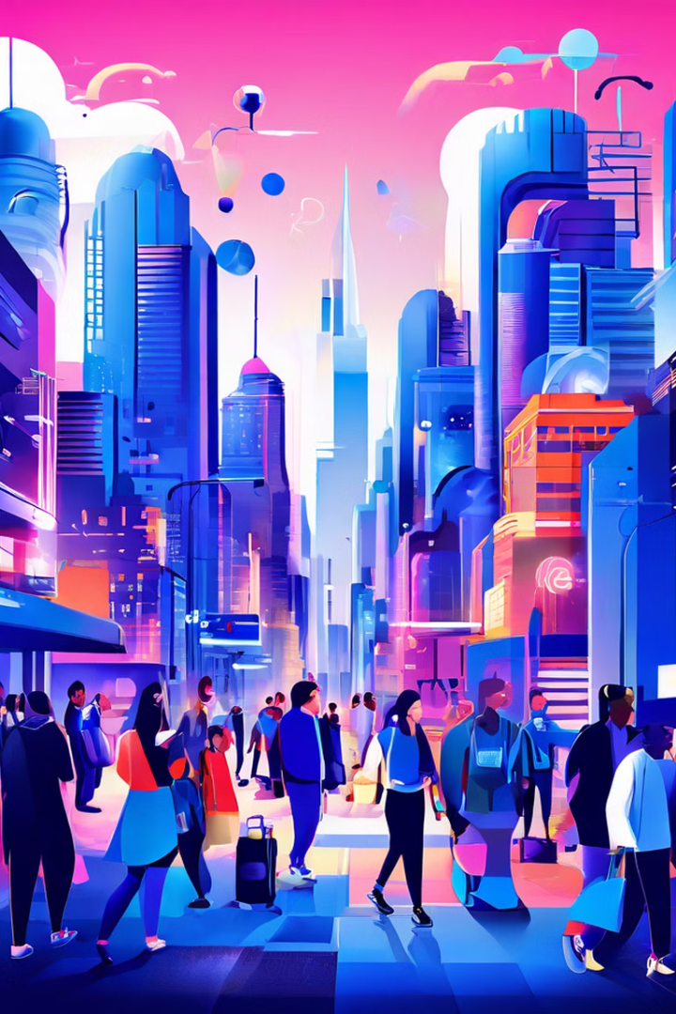
Societal Consequences
Social Exclusion
Marginalization and isolation of certain racial groups from opportunities and resources.
Economic Inequality
Disparities in income, wealth, and employment opportunities based on race.
Health Disparities
Unequal access to healthcare and higher rates of health problems among minority groups.
Violence and Crime
Increased risk of violence, discrimination, and criminal justice disparities faced by certain racial groups.

Slide 7
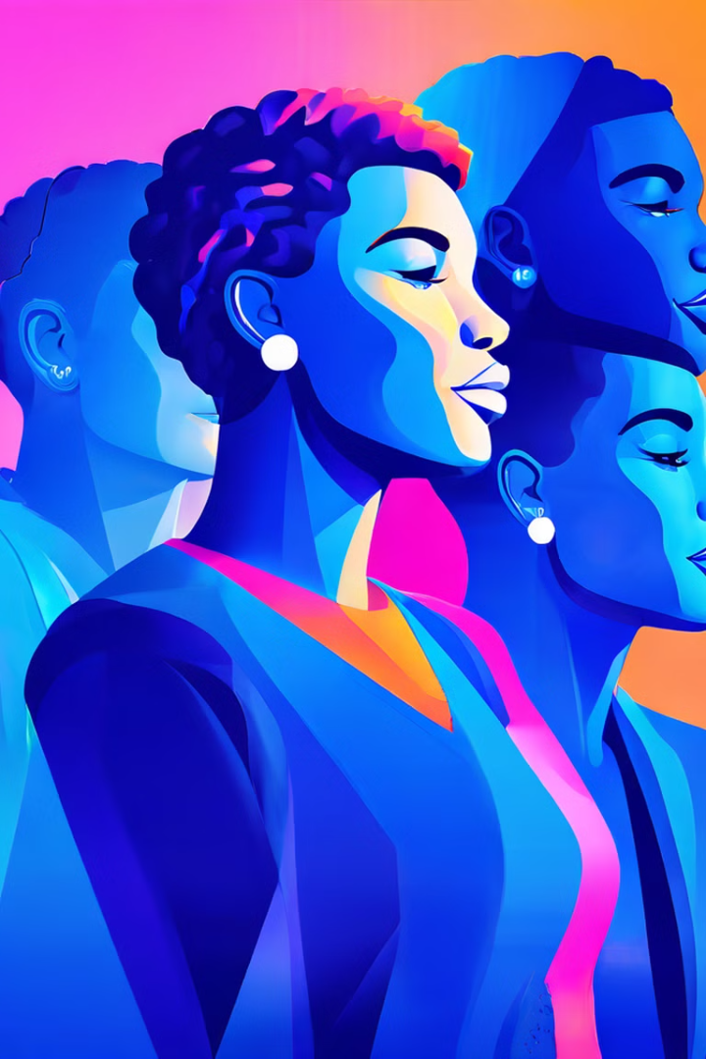

Addressing Racism and Discrimination
Education and Awareness
Diversity and Inclusion
Educating individuals about the history, causes, and consequences of racism and discrimination is crucial to foster understanding and empathy.
Promoting diversity and inclusion in workplaces, schools, and communities can create more equitable spaces for all.
Policy Reform
Anti-Racism Initiatives
Addressing systemic racism requires policy changes that eliminate discriminatory practices and create a more equitable society.
Anti-racism initiatives aim to actively dismantle racism and promote racial justice through various strategies, such as community organizing and advocacy.

Slide 8
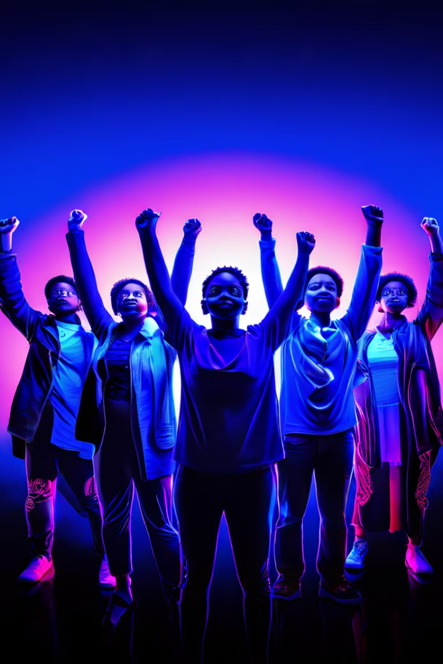
Conclusion and Call to Action
Racism and discrimination are deeply embedded in society, but by understanding their complexities, promoting education and awareness, and advocating for systemic change, we can work towards a more just and equitable future for all.

